Slide 1
Becoming a
Computational Thinker
Yasemin Gulbahar, PhD

Slide 2
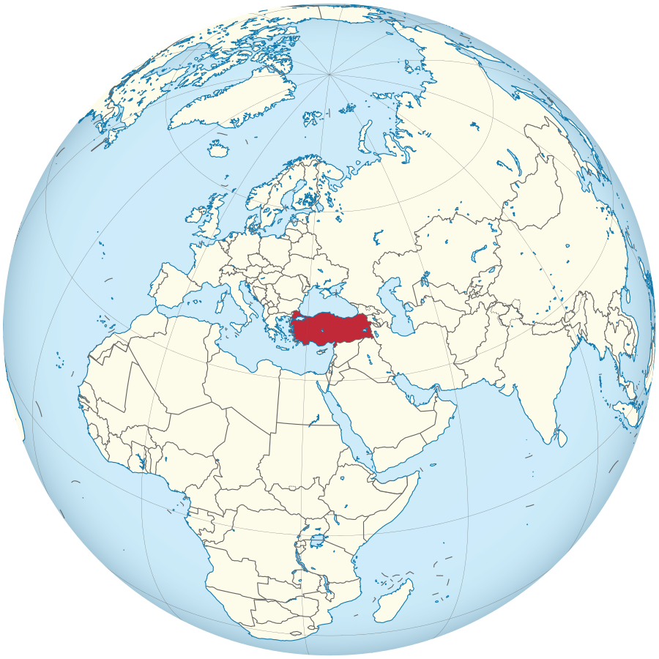
Hello, I am Yasemin!
BS, Mathematics (1992)
MS, Science Education (1999)
PhD, Computer Science Education & Instructional Technology (2002)
Professor since 2014
Educator: Visiting Prof @Teachers College, Dept of Human Development, Learning Analytics
Researcher: Google h-index 32
Interdisciplinary Expertise

Slide 3
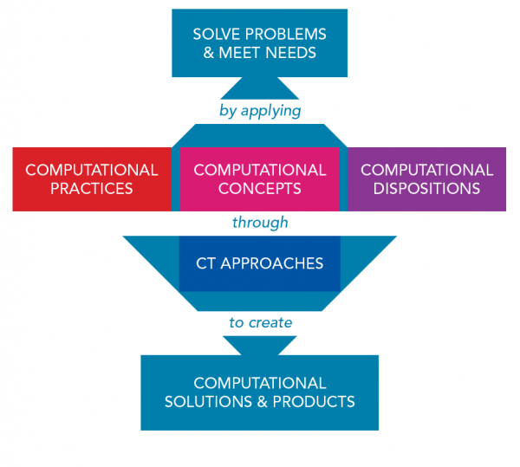
Computational Thinking: Definition, Concepts and Practices

Slide 4
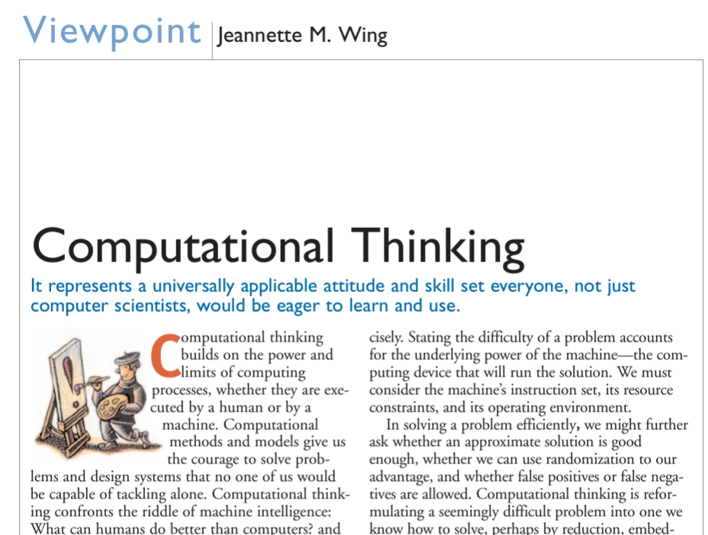
What is Computational Thinking?
a skill for everyone needed for the 21st century
problem solving through technology/computers
designing systems
understanding human behavior
thinking recursively
using heuristic reasoning to discover a solution
planning, learning, and scheduling in the presence of uncertainty
dealing with complexity
2006

Slide 5
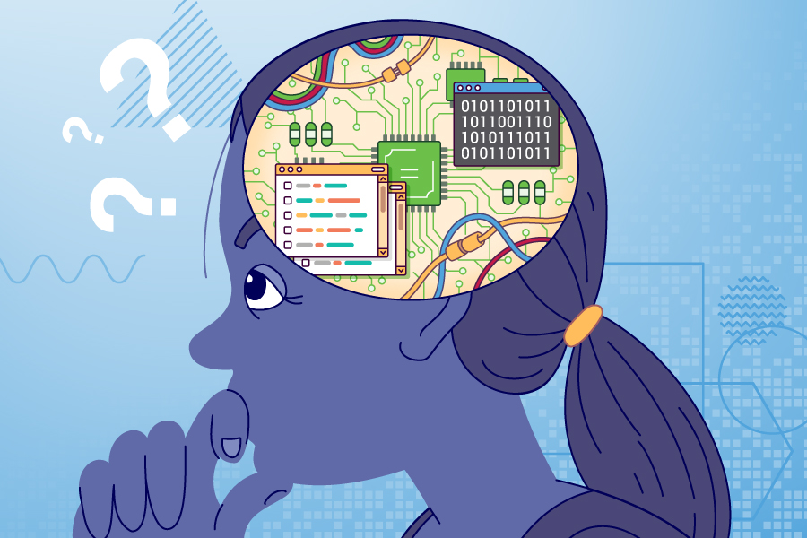
Characteristics of Computational Thinking
Conceptualizing, not programming
Fundamental, not rote skill
A way that humans, not computers, think
Complements and combines mathematical and engineering thinking
Ideas, not artifacts
For everyone, everywhere

Slide 6

Computational Practices (Skills)
Logical Thinking
Logical thinking means thinking using logic. It involves starting with a premise (information that you believe to be true) and then using reasoning to come up with a conclusion that makes sense based on the premise.
Examples
Deductive: uses a specific premise that leads to a specific and accurate conclusion (e.g., All squares are rectangles. All rectangles have four sides; therefore, all squares have four sides.).
Inductive: uses a specific premise that leads to a broad and not necessarily accurate conclusion (e.g., The grade 6 students in the class like gym period; therefore, all grade 6 students like gym period.).
https://letstalkscience.ca/educational-resources/backgrounders/computational-thinking

Slide 7

Computational Practices (Skills)
Abstraction
Abstraction is about reducing the complexity of a problem or task by focusing on what is important, capturing relevant information and removing unnecessary details.
Examples
Identify the most important skills for a baseball pitcher.
Represent the actions run, stop and hop using images.
Code a simulation of a volcano erupting.
Identify the appropriate formula to use to solve a physics problem.
https://letstalkscience.ca/educational-resources/backgrounders/computational-thinking

Slide 8

Computational Practices (Skills)
Algorithmic thinking/Algorithm Design
An algorithm is a series of ordered, logical and unambiguous rules or instructions necessary to solve a problem or achieve an objective.
Examples
What steps are needed to make a sandwich?
Does it matter if the steps are done in a different order? Why or why not?
Create an algorithm that would help you decide what to wear each day.
Create an algorithm that can help you identify the birds in your backyard.
Create an algorithm to teach a young child how to tie shoelaces in a bow.
https://letstalkscience.ca/educational-resources/backgrounders/computational-thinking

Slide 9

Computational Practices (Skills)
Decomposition
Decomposition involves breaking down a problem into smaller parts or sub-problems. Working with smaller subsets of a problem can reduce the overall complexity of a problem.
Examples
Identify all of the tasks you will need to do in order to bake a cake.
Explain how the parts of a dragonfly make it an effective predator.
Create a video game with your friends. How could you divide up the tasks?
Create a code that will convert a value in Fahrenheit to one in Celsius. What are the major parts and processes?
https://letstalkscience.ca/educational-resources/backgrounders/computational-thinking

Slide 10

Computational Practices (Skills)
Pattern Recognition
Pattern recognition involves being able to recognize and use patterns to describe and represent sequences in data or processes. Pattern recognition also enables previously successful methods to be applied to new problems, sometimes leading Generalization.
Examples
What pattern do you notice when you draw a square? How could you apply that knowledge to drawing a pentagon?
Which notes are repeated in the music? When are those parts repeated?
In baseball, what happens after you receive two strikes? What about three strikes?
https://letstalkscience.ca/educational-resources/backgrounders/computational-thinking

Slide 11

Computational Practices (Skills)
Data Collection & Analysis
Data collection is a planned approach of selecting and gathering information in an effort to answer a question or solve a problem. Analyzing data involves observing data to determine patterns such as repeated results, upward and downward trends, Modelling, etc.
Examples
How many animals cross the road in this location after dark? How will you collect this data?
What do you notice about the germination of our seeds over the last two weeks?
What is the most common species of bird at our class bird feeder? What data would you need to collect? How will you collect it?
What was the average time it took for the toy cars to go down the ramp?
https://letstalkscience.ca/educational-resources/backgrounders/computational-thinking

Slide 12

Computational Practices (Skills)
Data Representation
In order to be able to analyze and communicate findings, it is often useful to represent the data in a more human-friendly format such as a table, chart, graph, infographic, etc. which is also called Visualization.
Examples
What cities in Canada have the highest level of carbon dioxide in their classrooms? What is the best way to represent this data?
How would you organize data about daily rainfall in major cities to help researchers compare rainfall between time periods and places in the future?
What is the most useful way to organize your math test scores to help you analyze your progress?
https://letstalkscience.ca/educational-resources/backgrounders/computational-thinking

Slide 13

Computational Practices (Skills)
Debugging
When a computer code does not do what you think it is going to do, it may contain errors. Errors in computer code, or programs, are known as ‘bugs.’ Debugging involves finding and correcting bugs.
Examples
Why does the computer say that the code doesn’t compile, is it because of a spelling mistake?
Why does your program give an unexpectedly large answer, is it because of a logic error?
What simple tests could you run to help you find the mistake in this program?
https://letstalkscience.ca/educational-resources/backgrounders/computational-thinking

Slide 14

Computational Practices (Skills)
Testing and Evaluating
Testing involves trying something and observing what happens. Evaluation is about using critical thinking and judgement to determine if a set of criteria are met. If not, then correction or improvement may be required.
Examples
Did the animated character move in the way you expected it to?
What happened when you tested the robot? Was it able to shoot the ball into the net every time?
What happened when you downloaded the code for scrolling your name onto the micro:bit? Did it scroll the letters of your name across the LED display in the correct order?
https://letstalkscience.ca/educational-resources/backgrounders/computational-thinking

Slide 15

Computational Concepts
Conditionals
Conditional statements give rules to direct the flow of what happens, such as if something is true, then something will happen or else something else will happen.
Examples
If it is raining outside then you will need to put on your rain boots, else wear your running shoes.
If the sensor reads a temperature greater than 25ºC, then show a happy face display, else if the sensor reads a temperature less than 25ºC then show a sad face display.
If you get to a fork in the maze then turn left else go straight on.
If (hour < 18:00) {greeting = “Good day”;} else {greeting = “Good evening”:}
https://letstalkscience.ca/educational-resources/backgrounders/computational-thinking

Slide 16

Computational Concepts
Data
Data (values stored by computer) types are computer language-specific, but they commonly include types such as characters, strings, integers, fixed and floating point numbers and the Boolean data type.
Examples
Character (e.g., A); String (e.g., Hello!); Integer (e.g., 12)
Floating-point number (float) (e.g., 15.2203829) - can have a variable number of digits after the decimal
Boolean (true or false value) - can be understood to mean on/off or start/stop
If you want to keep track of how many goals were scored, which data type will you use? (integer)
If you want to store information about whether the light is on or off, which data type will you use? (Boolean)
https://letstalkscience.ca/educational-resources/backgrounders/computational-thinking

Slide 17

Computational Concepts
Events
An event involves having one action cause another action, such as how you get a computer to respond to the input of a user. User inputs include actions such as clicking a mouse, tapping a key or touching a screen.
Examples
Zooming in on a map when someone clicks on it
Scrolling through images on a phone when someone swipes the screen
Adjusting the volume on a video when someone presses the + or - buttons
https://letstalkscience.ca/educational-resources/backgrounders/computational-thinking

Slide 18

Computational Concepts
Functions
Functions group all the steps of a complex action into one command, they are especially useful for defining a sequence of commands that can be reused.The creation of functions is based on pattern recognition, abstraction and logical thinking.
Examples
Function: Brush Teeth (involves turning on the water, putting toothpaste on toothbrush, etc.)
Function: Draw a Square (draw a straight line of 3 cm, turn 90º, draw a straight line of 3 cm , turn 90º, draw a straight line of 3 cm, turn 90º, draw a straight line or 3 cm, turn 90º)
Function: Header style <h1 style=“color:Gray;”>
https://letstalkscience.ca/educational-resources/backgrounders/computational-thinking

Slide 19

Computational Concepts
Inputs and Outputs
Input and output (I/O) is the communication that occurs between humans and computers, computers and other computers, among processes within a computer, or between a computer/robot and its environment.
Examples
Humans provide input into computers using peripherals such as a keyboard, mouse, webcam, microphone, etc.
Computers provide output using speakers, a screen, printers, etc.
Robots use input devices such as sensors (light sensor, temperature sensor, etc.), buttons, etc.
Robots’ output devices include motors, speakers, actuators, lights, etc.
https://letstalkscience.ca/educational-resources/backgrounders/computational-thinking

Slide 20

Computational Concepts
Operators
Operators are characters that tell the computer to perform certain mathematical or logic-based actions, like +, -, *, /, <, >, ==, as well as logic-based operations such as AND (&&), OR (II) and NOT (!).
Examples
What is the sum of the ages of everyone in your family? (ageMe + ageBrother + ageMom + ageDad)
Is your brother older than you? (ageBrother > ageMe)
Greater then and less than return Boolean results (true or false) in most programming languages
https://letstalkscience.ca/educational-resources/backgrounders/computational-thinking

Slide 21

Computational Concepts
Repetition (Loops)
Repetition involves repeating a step or steps in an algorithm a certain number of times until a certain predetermined end point is reached. Loops help programs be more organized and shorter. Repetitions can also lead Automation.
Examples
Explain to someone else the most efficient way of making 100 sandwiches.
Set up a light to turn on and off at certain times every day.
Code a car game so that the car will automatically go around the track 10 times.
Create a piece of art that involves a repeating pattern, like a mosaic tile, mandala, or fractal.
https://letstalkscience.ca/educational-resources/backgrounders/computational-thinking

Slide 22

Computational Concepts
Sequences
The steps in an algorithm always follow a sequence. Sequences are rarely linear and may involve tasks which are repeated or only occur under certain conditions. A flowchart is a good tool for understanding and representing sequences.
Examples
What are the steps you need to do to……? (e.g., change a tire, brush your teeth, make toast). Are there any steps that you repeat?
Writing out the rules for a game (e.g., what happens first, next, last)
Describing how you get to school using a map (e.g., where do you start? When do you turn? Where do you end?)
Explain to someone else how to draw a square of a specific perimeter.
https://letstalkscience.ca/educational-resources/backgrounders/computational-thinking

Slide 23
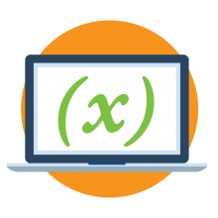
Computational Concepts
Variables
Variables are places where you can store and retrieve data. Variables have names that stand in for the data they hold, which makes them an abstract concept since one thing (variable name) represents something else (data).
Examples
var a = 10; var b = 5; a and b are the names of the variables and the = tells you what data is stored in each variable.
The variable “age” could represent people’s ages (e.g., var age;).
The variable “rateGrowth” could be used to keep track of a plant’s growth over a certain period of time (e.g., var rateGrowth;).
The variable “temperature” could be used to store and retrieve the temperature readings from a sensor.
The variable “StudentName ” could be used to store a student’s name and insert it automatically in a personalized email.
https://letstalkscience.ca/educational-resources/backgrounders/computational-thinking

Slide 24
Computational Thinkers
Practices
Logical Thinking
Abstraction
Algorithm Design
Data Collection & Analysis
Data Representation
Debugging
Decomposition
Pattern Recognition
Testing & Evaluating
Concepts
Conditionals
Data
Events
Functions
Input and Output
Operators
Repetition (Loops)
Sequences
Variables
Approaches
Tinker
Make
Reuse & Remix
Unplugged
Create
Collaborate
Debug
Persevere

Slide 25
Problem Solving Session
Mazes
Towers of Hanoi

Slide 26
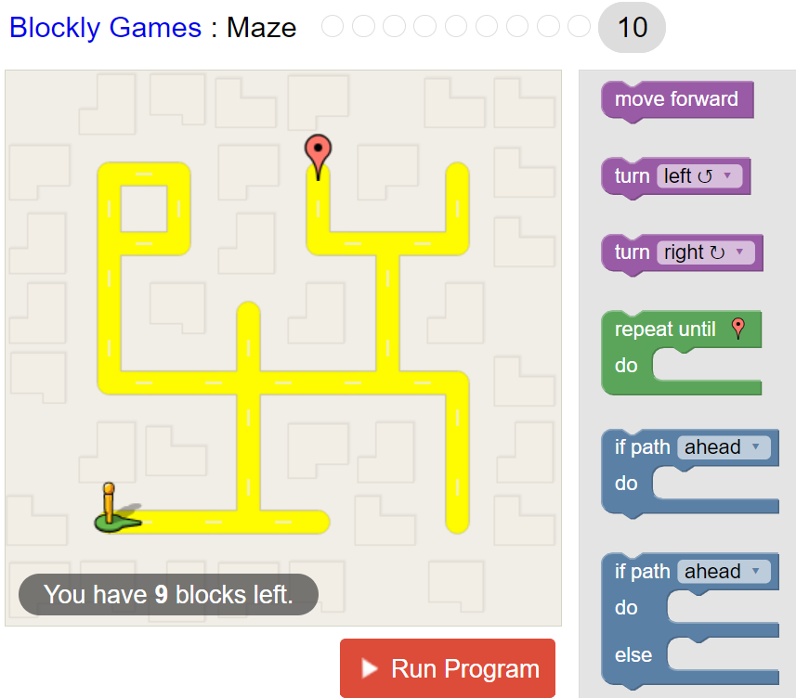
Building a Maze Solver
Block-Based Approach Blockly Games: Maze Level 10
Blockly Games

Slide 27
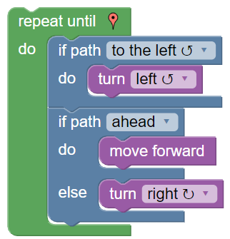
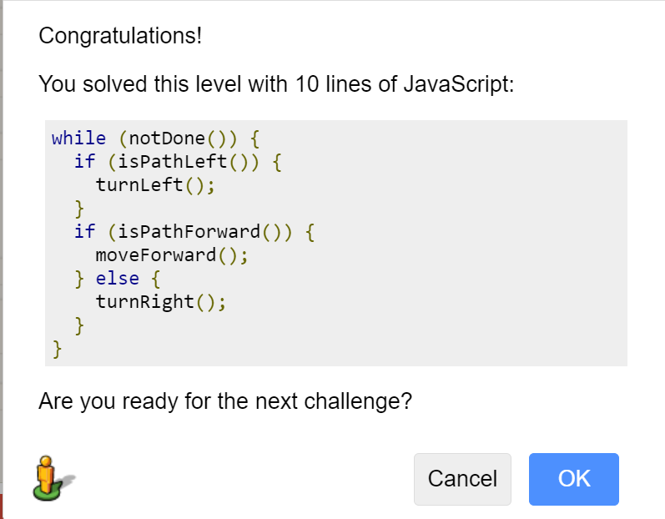
Solution of Blockly Games Maze Level 10

Slide 28
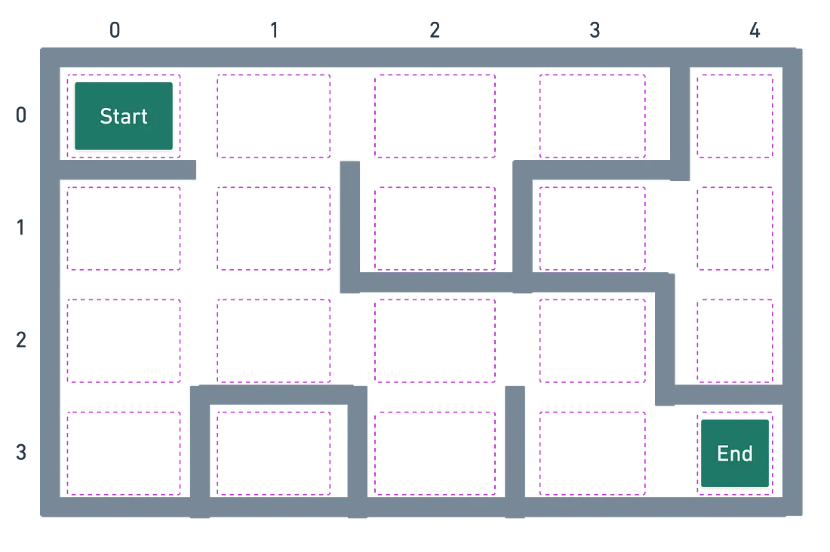
How to model a maze?
Each maze has a starting point and an ending point.
Mazes are composed of walls.
Our goal is to find the first available path through the maze.

Slide 29
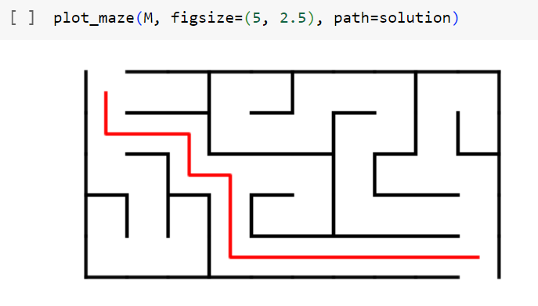
Building a Maze Solver
with Python (Breadth-First Search)
Text-based Approach
Python (Tutorial Google Colab)
Maze Solver Colab Tutorial

Slide 30
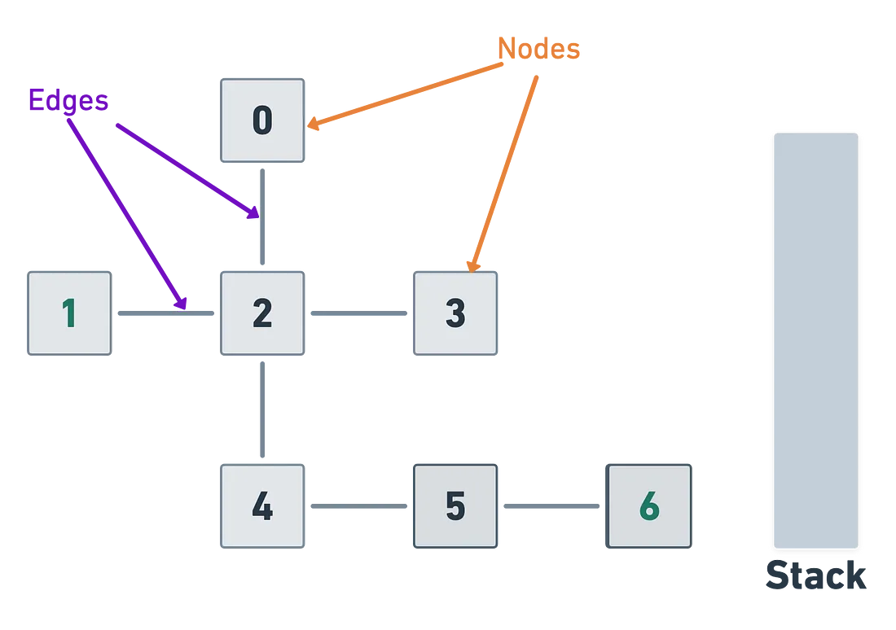
How to solve a maze?
One way to represent a graph. There are many ways to represent graphs but for this example, we’re only concerned with the fact that our graph contains nodes and edges.
Graphs typically don’t have a designated starting point but in order to perform DFS, we have to start somewhere so we’ll start with Node 1.

Slide 31
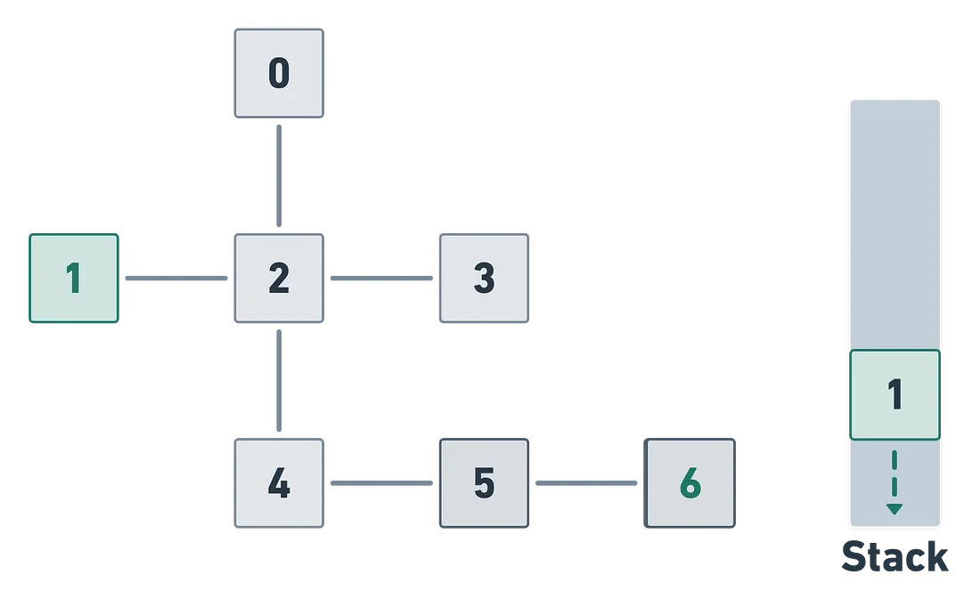
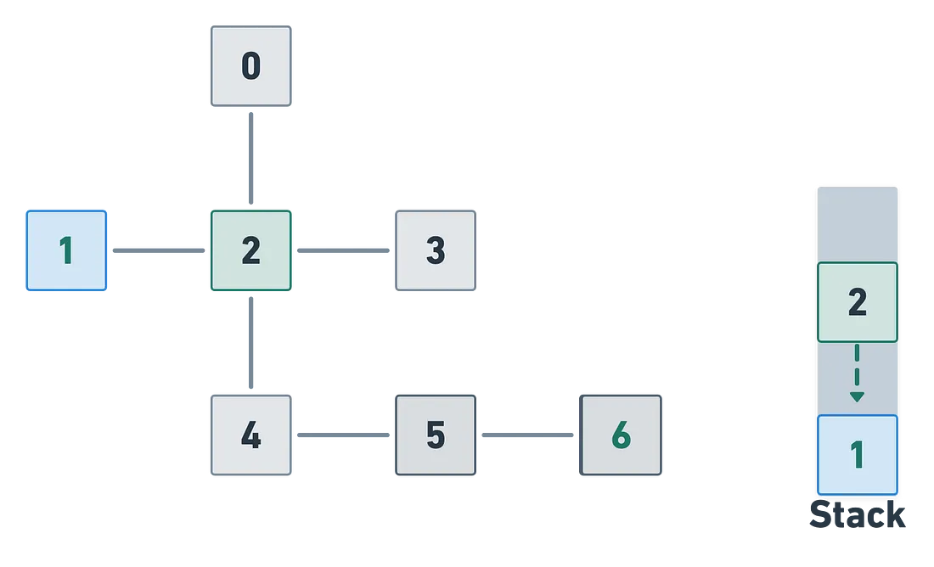
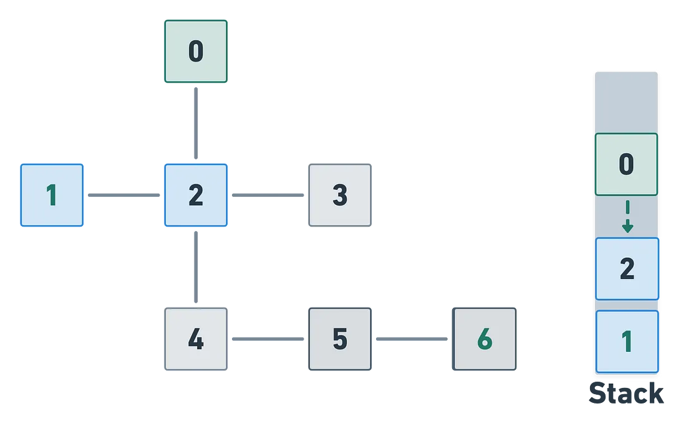
Solution Steps
Step 1
Step 2
Step 3

Slide 32
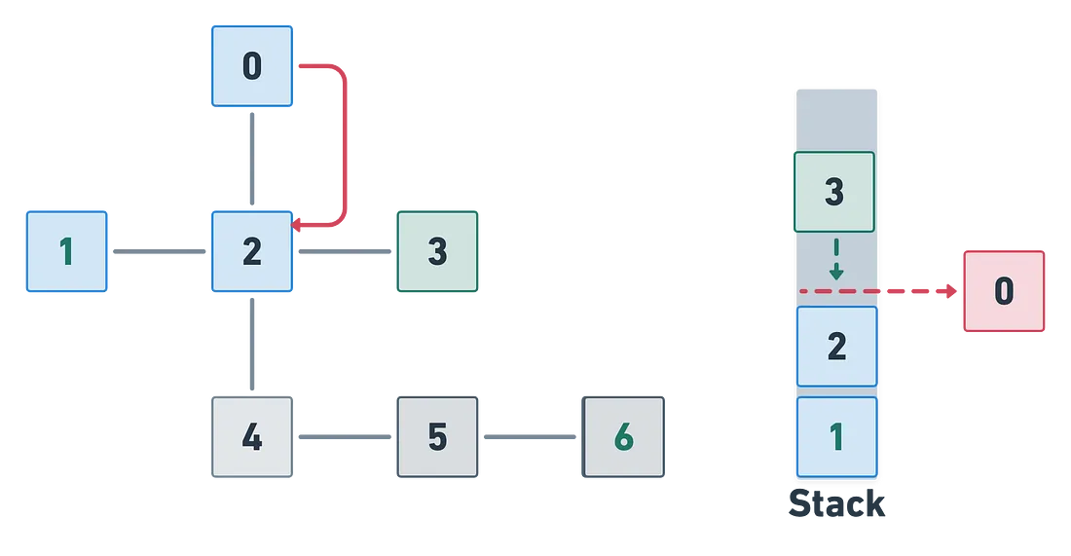
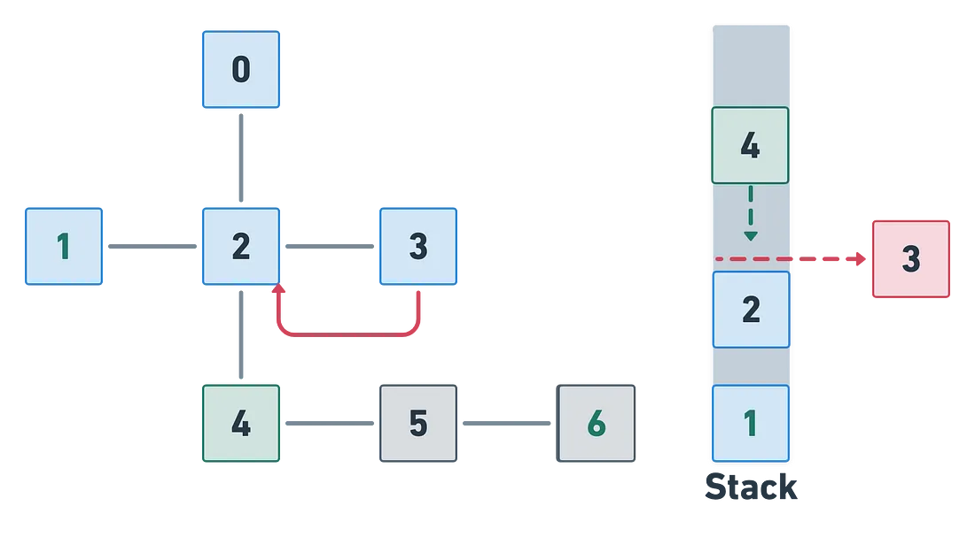
Solution Steps
Step 4
Step 5

Slide 33
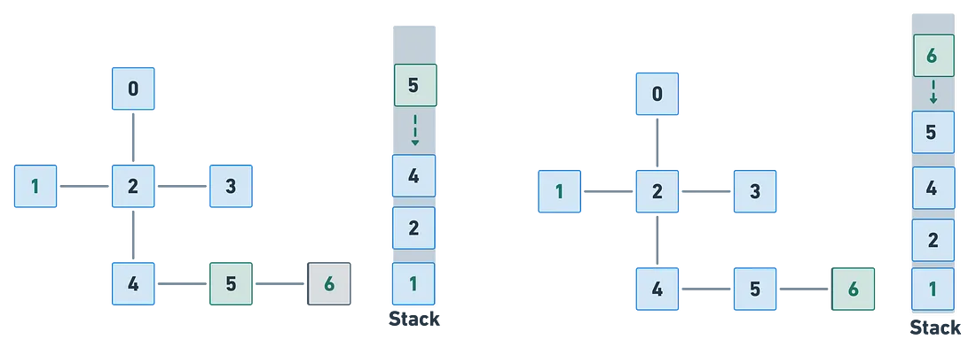
Solution Steps
Step 6
Step 7

Slide 34
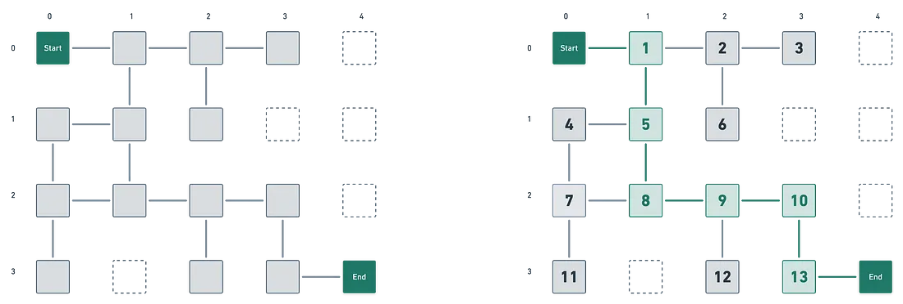

Slide 35
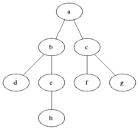

Breadth-First Search

Slide 36
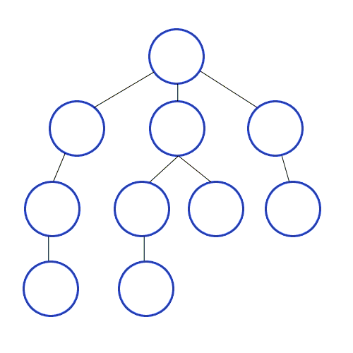
Using Recursive Depth-First Search
DFS is a recursive algorithm, which means that it calls itself to explore each branch of the graph.
Choose a starting cell.
Mark the starting cell as visited.
If the current cell is the end cell, stop.
Otherwise, check all the unvisited neighbors of the current cell.
If there are no unvisited neighbors, backtrack to the previous cell.
Otherwise, choose one of the unvisited neighbors and go to step 2.

Slide 37
Using Recursive Depth-First Search
ITERATIVE procedure DFS_iterative(G, v) is
let S be a stack
S.push(v)
while S is not empty do
v = S.pop()
if v is not labeled as discovered then
label v as discovered
for all edges from v to w in G.adjacentEdges(v) do
S.push(w)
RECURSIVE
procedure DFS(G, v) is
label v as discovered
for all directed edges from v to w that are in G.adjacentEdges(v) do
if vertex w is not labeled as discovered then
recursively call DFS(G, w)

Slide 38
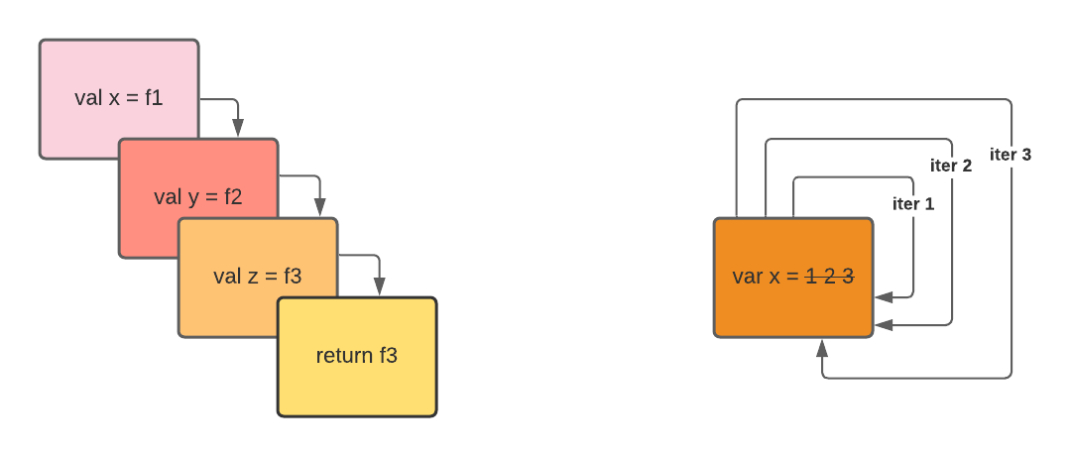
Why would you ever use recursive DFS over iterative DFS? Is iteration faster than recursion?

Slide 39
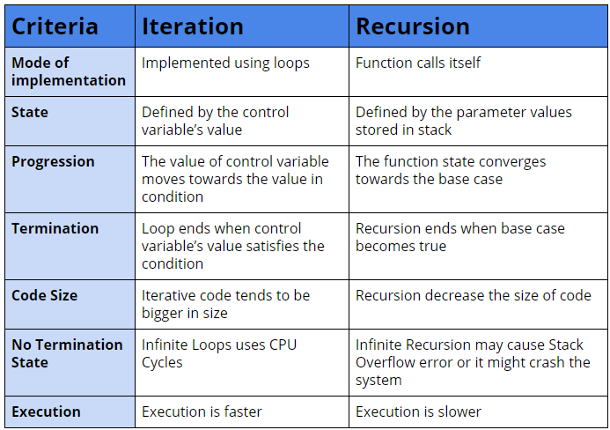
Why would you ever use recursive DFS over iterative DFS? Is iteration faster than recursion?

Slide 40
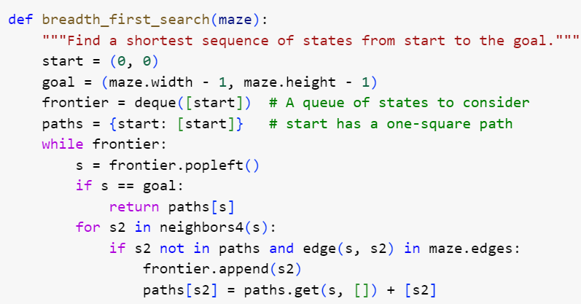
Building a Maze Solver
Block-Based Approach Blockly Games: Maze Level 10
Text-based Approach
Maze Solver Colab Tutorial

Slide 41
CT Processes for Solution of Maze
Let us talk!
Practices
Logical Thinking
Abstraction
Algorithm Design
Data Collection & Analysis
Data Representation
Debugging
Decomposition
Pattern Recognition
Testing & Evaluating
Concepts
Conditionals
Data
Events
Functions
Input and Output
Operators
Repetition (Loops)
Sequences
Variables
Approaches
Tinker
Make
Reuse & Remix
Unplugged
Create
Collaborate
Debug
Persevere

Slide 42

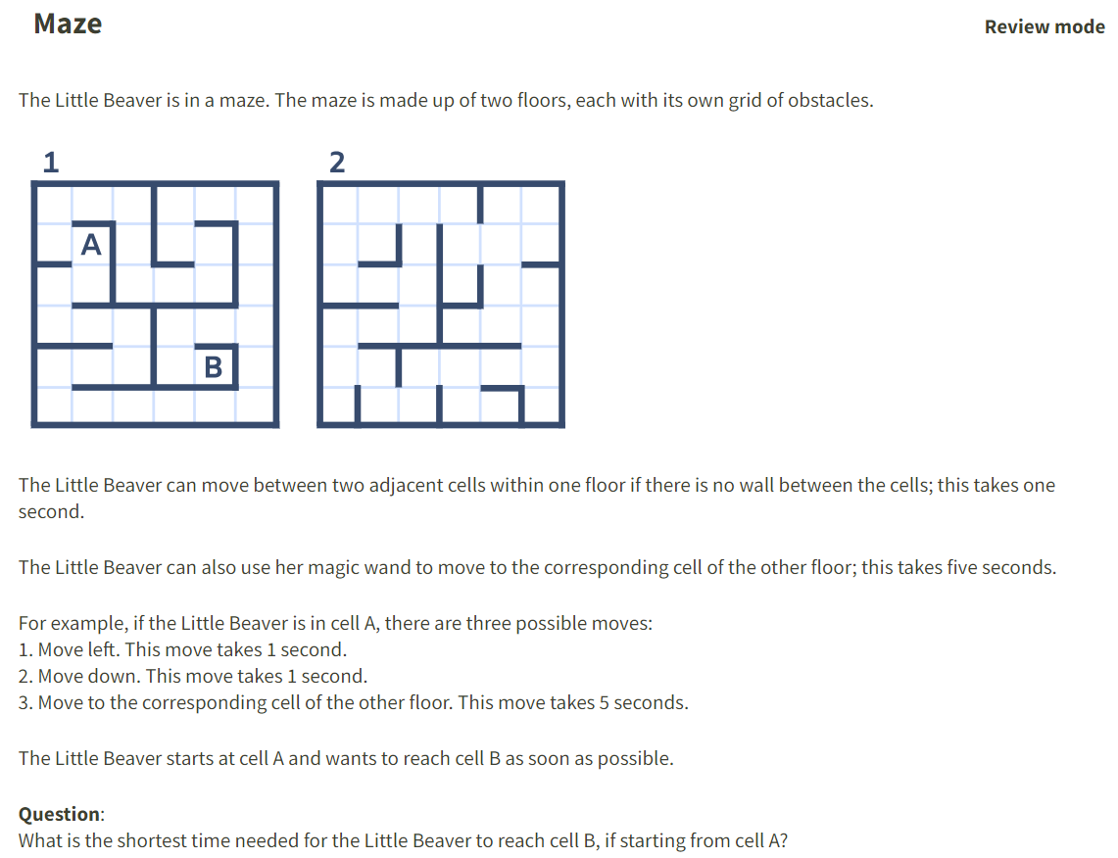
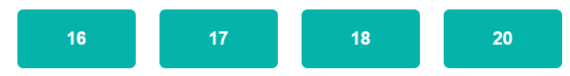

Slide 43
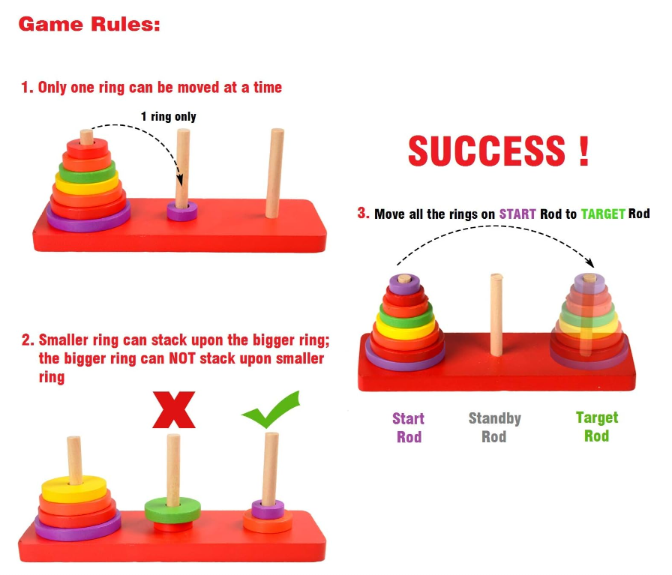
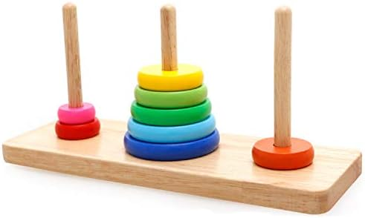
Exploring Towers of Hanoi
Game-Based Approach Play Towers of Hanoi
CS Unplugged
Approach

Slide 44
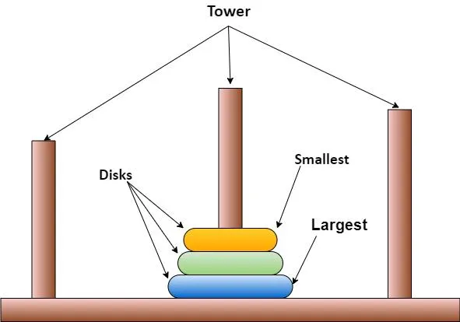
How to model Towers of Hanoi?
Simple rules:
Only one disk can be moved at a time.
Each move consists of taking the upper disk from one of the stacks and placing it on top of another stack or on an empty rod.
No disk may be placed on top of a smaller disk.
The minimal number of moves required to solve a Tower of Hanoi puzzle is 2^n - 1, where n is the number of disks.

Slide 45
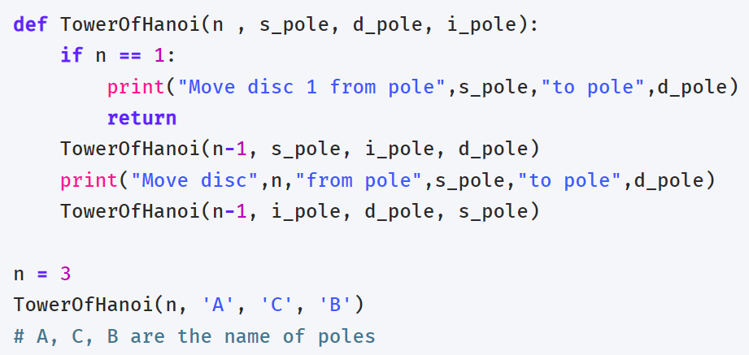
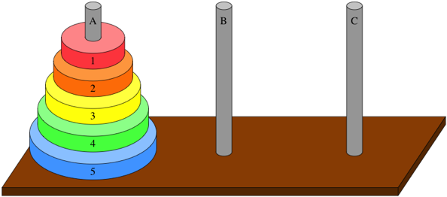
Exploring Towers of Hanoi
Text-based Approach Python (Tutorial Google Colab)

Slide 46
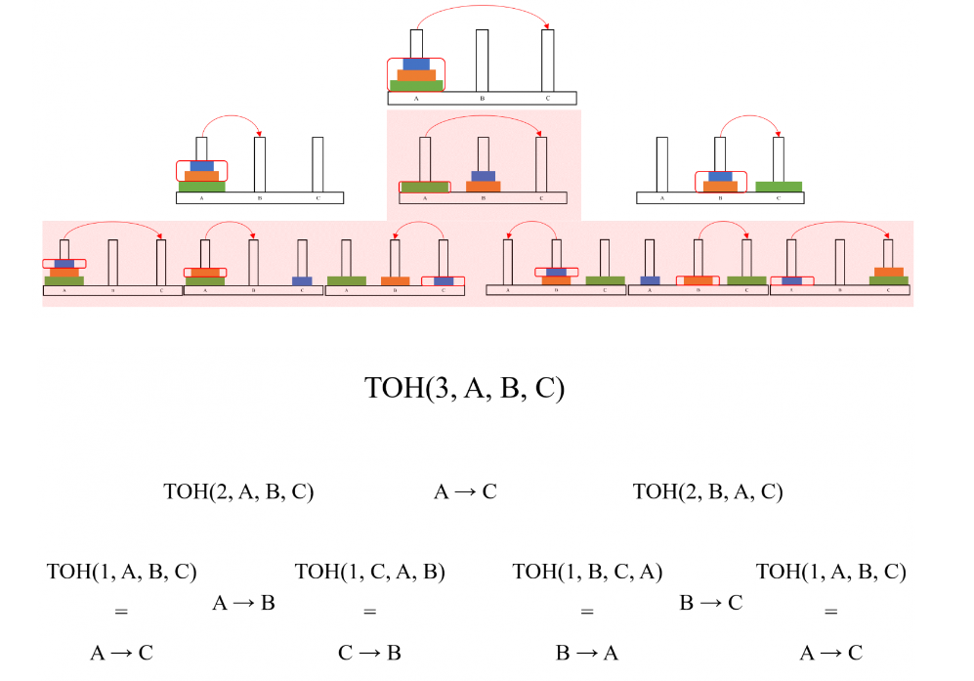
Solving Towers of Hanoi Recursively
Text-based Recursive Approach Python
(Source Code)
To move the bottom disk, we need to move all the disks adobe it to another tower first. Then we can move the bottom disk to the empty tower and move the (n-1) remaining disks back on top of it. Namely:
Move top (n-1) disks from tower A to B
Move the bottom disk from tower A to C
Move top (n-1) disks from tower B to C

Slide 47
CT Processes for Towers of Hanoi
Let us talk!
Practices
Logical Thinking
Abstraction
Algorithm Design
Data Collection & Analysis
Data Representation
Debugging
Decomposition
Pattern Recognition
Testing & Evaluating
Concepts
Conditionals
Data
Events
Functions
Input and Output
Operators
Repetition (Loops)
Sequences
Variables
Approaches
Tinker
Make
Reuse & Remix
Unplugged
Create
Collaborate
Debug
Persevere

Slide 48

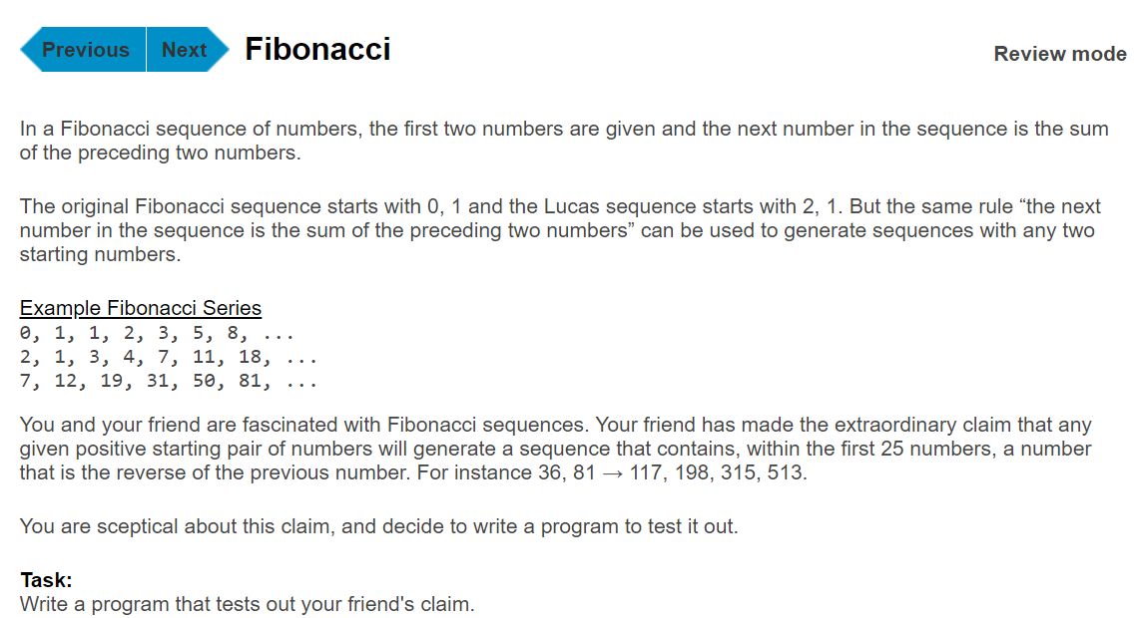

Slide 49
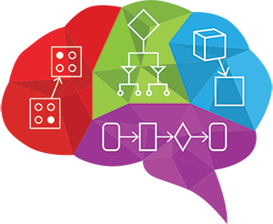
CT Tools & Approaches
Pedagogical Approaches for Learning
CS Unplugged
Paper - Pencil
Tangible items
Block-based programming
Game-based learning
Text-based Programming
Problems/Tasks for Concepts (Recursive)
Solving a Maze
Towers of Hanoi
To teach all practices of Computational Thinking!

Slide 50
Thank you for participating! Questions & Comments
Yasemin Gulbahar gulbahar@tc.columbia.edu

